Slide 1


Slide 2
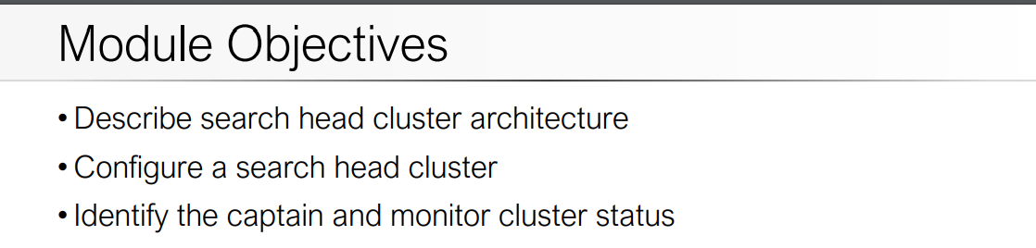

Slide 3
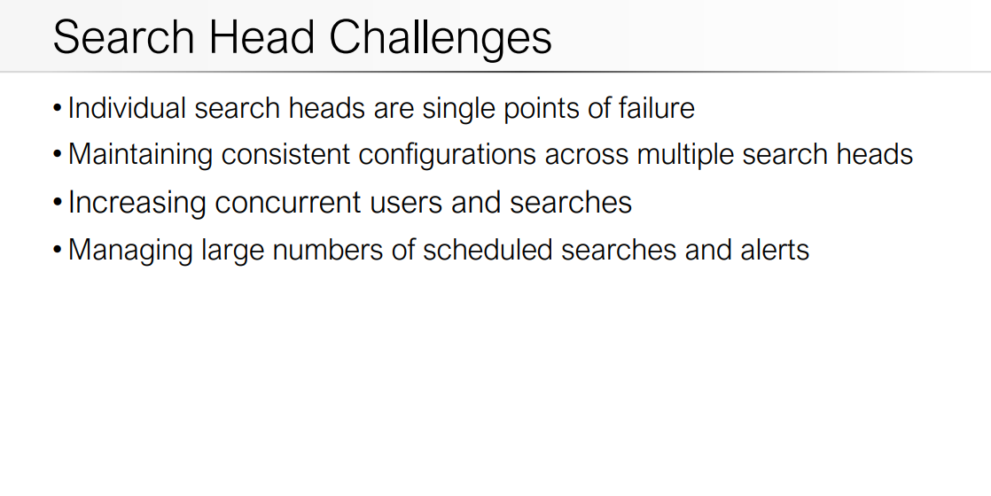

Slide 5
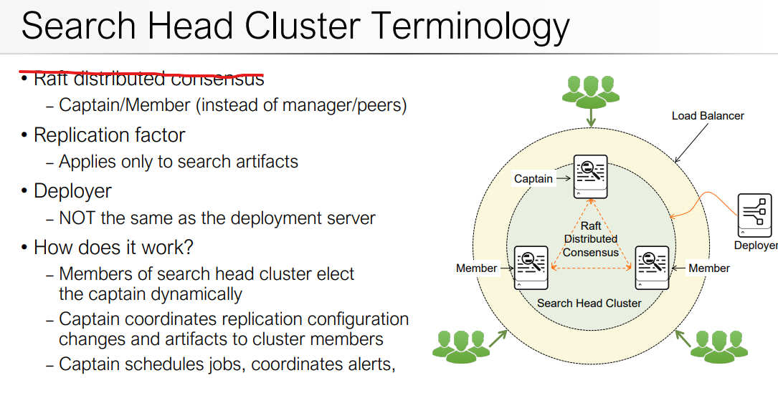

Slide 6
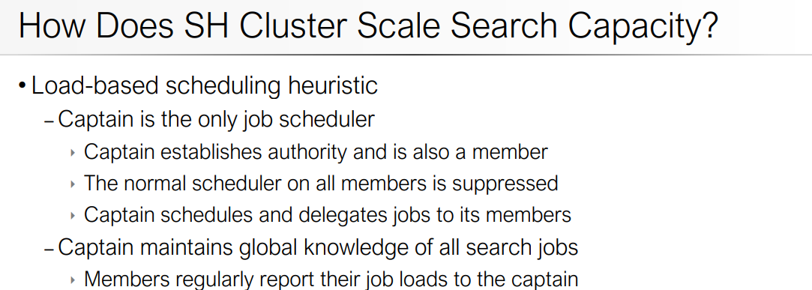

Slide 7
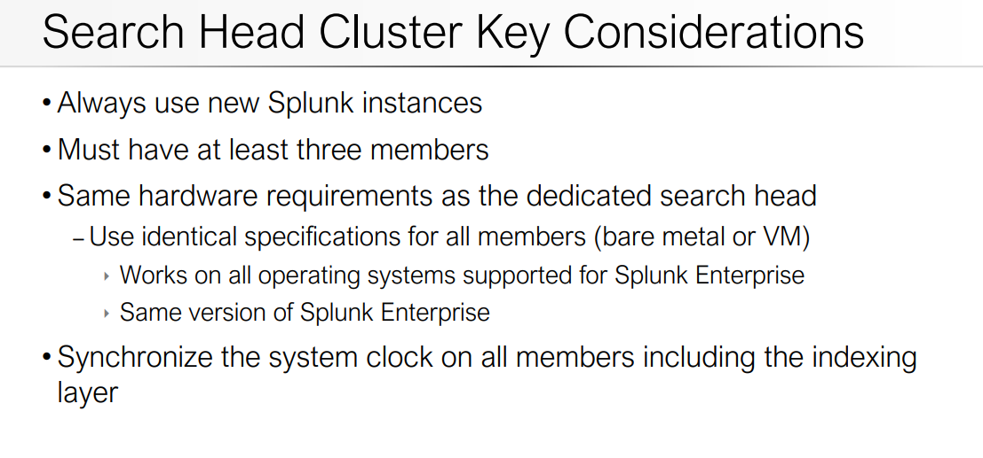

Slide 8
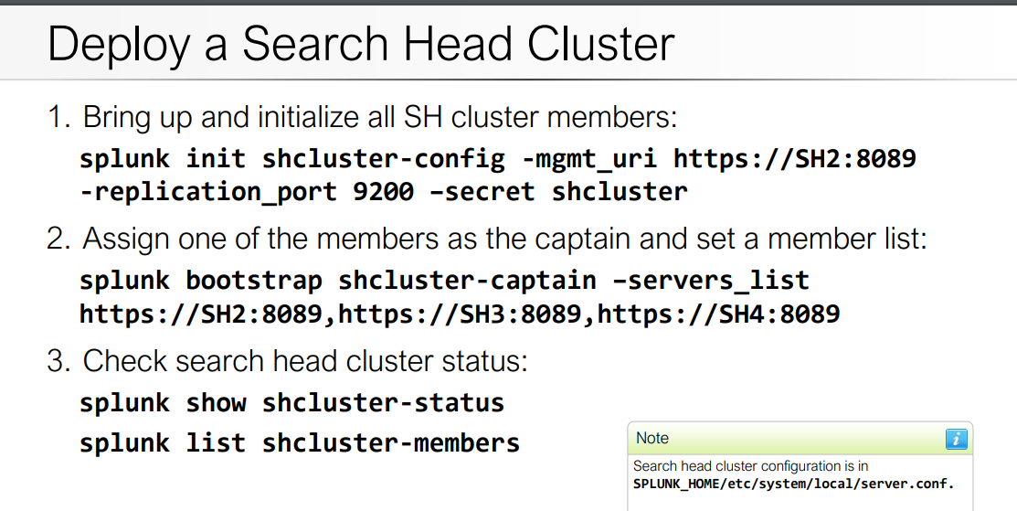

Slide 9
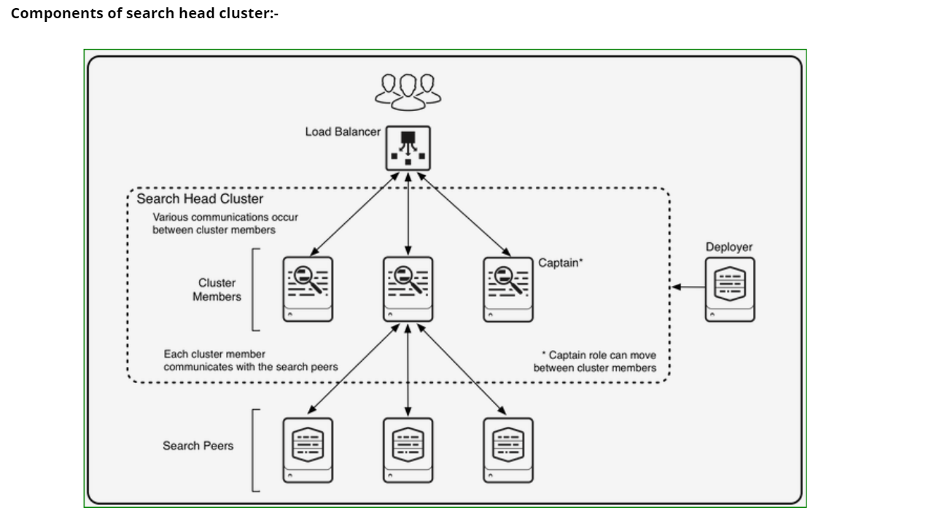

Slide 10
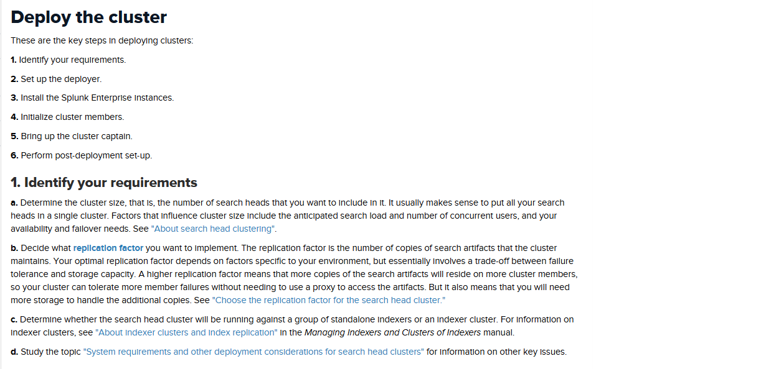

Slide 11
The deployer –This is a Splunk Enterprise instance that distributes apps and other configurations to the cluster members. It stands outside the cluster and cannot run on the same instance as a cluster member. It can, however, under some circumstances, reside on the same instance as other Splunk Enterprise components, such as a deployment server or an indexer cluster master/manager node

Slide 12
Search peers – These are the indexers that cluster members run their searches across. The search peers can be either independent indexers or nodes in an indexer cluster. Load balancer – This is third-party software or hardware optionally residing between the users and the cluster members. With a load balancer in place, users can access the set of search heads through a single interface, without needing to specify a particular one.

Slide 13
Implement search head cluster Determine cluster size 1. Make sure all insatance to be included in cluster should 2. have same OS and version. 3. Install splunk package to all instances. 4. Determine replication factor and port. 5. Determine cluster will work along standalone indexer / or 6. indexer cluster. Requirements – 1) Deployer 2) Search Head Instances……(Sh-instance1, SH-instance2, SH-instance3)

Slide 14
IMPORTANT : replication_factor – It states that how many SH replication copies we need if we have 3 Sh instances and want to replicate 3 copies then -replication_factor is 3 if more instances then we can set more replication factor replication_port – we can define any port lets keep 8080 mgmt_uri – Own instance host ip address conf_deploy_fetch_url – Deployer host ip address 1) To initialize Deployer in Deployer Instance edit server.conf file and set configurations.

Slide 15
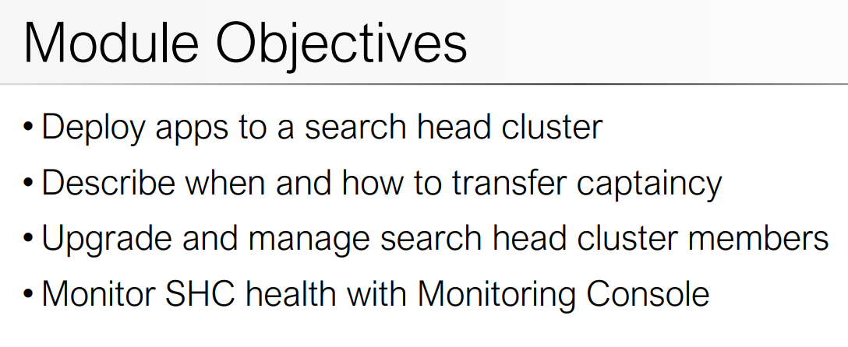

Slide 16
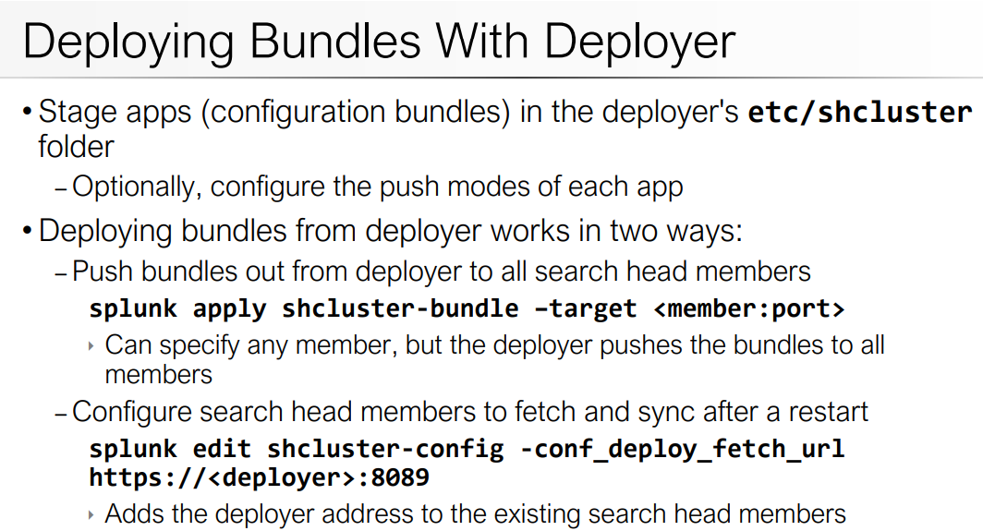

Slide 17
syslog-ng

Slide 18
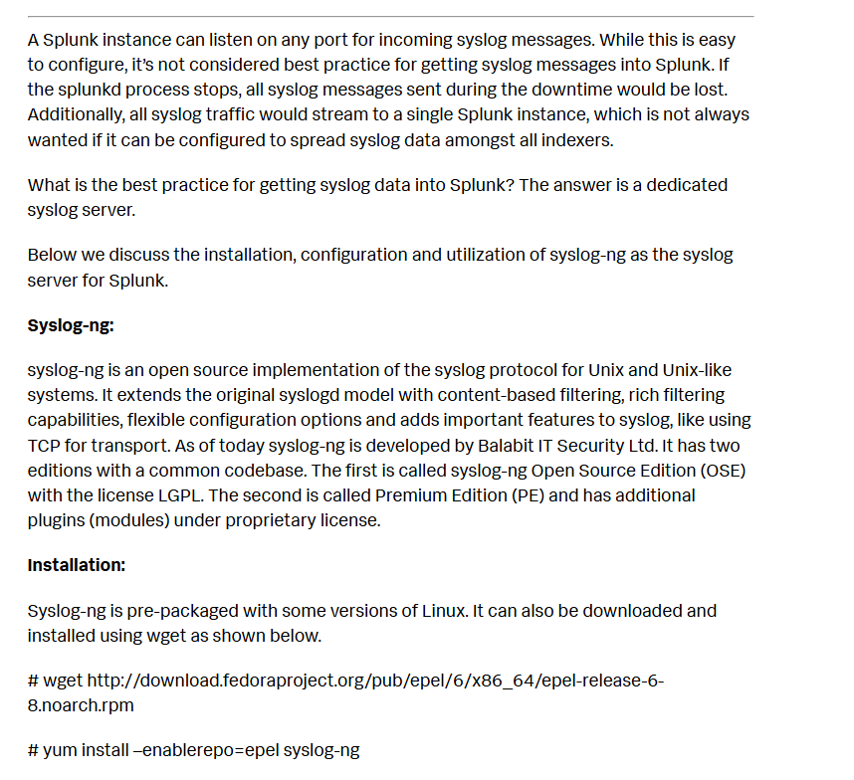

Slide 19
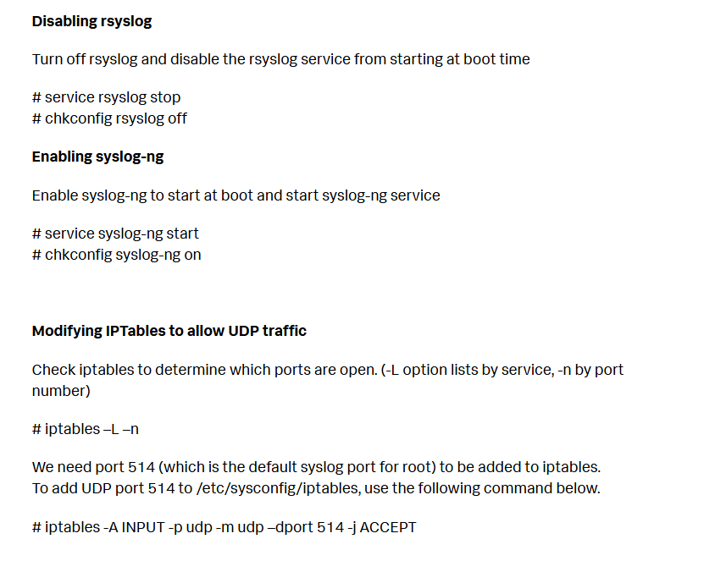

Slide 20
Modifying syslog-ng.conf Copy the existing syslog-ng.conf file to syslog-ng.conf.sav before editing it. The syslog-ng.conf example file below was used with Splunk 6. Each unique data source type had a directory created under /home/syslog/logs. This was done using destination options with the create_dirs attribute set to yes.
@version:3.2
# syslog-ng configuration file. # # options { chain_hostnames(no); create_dirs (yes); dir_perm(0755); dns_cache(yes); keep_hostname(yes); log_fifo_size(2048); log_msg_size(8192); perm(0644); time_reopen (10); use_dns(yes); use_fqdn(yes); };
source s_network { udp(port(514)); };

Slide 21
#Destinations destination d_cisco_asa { file(“/home/syslog/logs/cisco/asa/$HOST/$YEAR-$MONTH-$DAY-cisco-asa.log” create_dirs(yes)); }; destination d_palo_alto { file(“/home/syslog/logs/paloalto/$HOST/$YEAR-$MONTH-$DAY-palo.log” create_dirs(yes)); }; destination d_all { file(“/home/syslog/logs/catch_all/$HOST/$YEAR-$MONTH-$DAY-catch_all.log” create_dirs(yes)); };
# Filters filter f_cisco_asa { match(“%ASA” value(“PROGRAM”)) or match(“%ASA” value(“MESSAGE”)); }; filter f_palo_alto { match(“009401000570” value(“PROGRAM”)) or match(“009401000570” value(“MESSAGE”)); }; filter f_all { not ( filter(f_cisco_asa) or filter(f_palo_alto) ); };
# Log log { source(s_network); filter(f_cisco_asa); destination(d_cisco_asa); }; log { source(s_network); filter(f_palo_alto); destination(d_palo_alto); }; log { source(s_network); filter(f_all); destination(d_all); };
Restarting syslog-ng Syslog-ng can be restarted by executing the script in /etc/init.d or by issuing the service syslog-ng stop | start | restart commands shown below
# service syslog-ng stop Stopping syslog-ng: [ OK ]

Slide 22
Removing old log files from syslog-ng server To ensure syslog-ng doesn’t fill the filesystem up with log files, create a cron job which runs daily at 5AM to remove old syslog-ng log files after “x” days. The example below runs every morning at 5am and removes files older than 7 days.
# crontab –e 0 7 * * * /bin/find /home/syslog/logs/ -type f -name \*.log -mtime +7 -exec rm {} \;
Use the crontab –l command to see what other cron jobs may exist or to check to ensure the cron job scheduled is correct.
UF collection on syslog-ng server
Install a Universal Forwarder on the machine where the syslog-ng server is installed. The UF on the syslog-ng server can collect events from log files written from Cisco ASA and Palo Alto firewall devices. The monitor stanza below will monitor everything below the filesystem listed
Notice the attribute host_segment is used to identify the position of the hostname relative to the full path from the left.
# Cisco ASA [monitor:///home/syslog/logs/cisco/asa/*/*.log] sourcetype = cisco:asa index = cisco disabled = false host_segment = 6
Splunk walks the filesystem path to the sixth field and sets the hostname for the events to the value found.
/home/syslog/logs/cisco/asa/<hostname>/2014-09-10-cisco-asa.log

Slide 23
# Cisco ASA [monitor:///home/syslog/logs/cisco/asa/*/*.log] sourcetype = cisco:asa index = cisco disabled = false host_segment = 6
Splunk walks the filesystem path to the sixth field and sets the hostname for the events to the value found.
/home/syslog/logs/cisco/asa/<hostname>/2014-09-10-cisco-asa.log

Slide 24
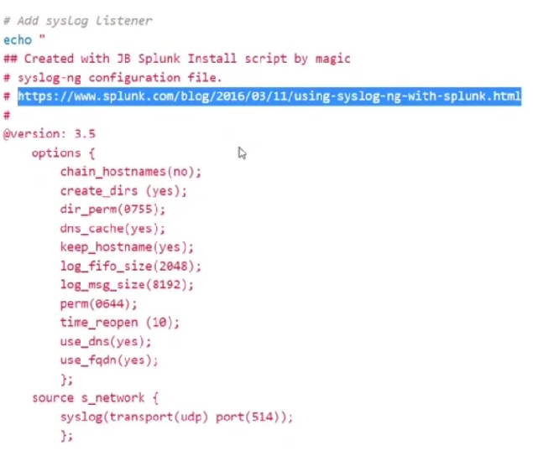

Slide 25
